Slide 2
LLM
Tools
User
Agent
MEM/storage

Slide 3
ERP
Ent DB
Agent
Tool
set / web acces
Tool set / web acces
User
Agent
SDK
Google
OpenAI
Local LLM /
deepseek /
Qwen
LLM

Slide 4
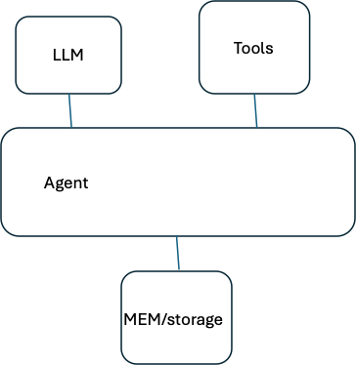
ERP
Ent DB
Agent
Tool
set / web acces
User
Agent
SDK
Antropic

Slide 5
Tool set / web acces
User
Google
OpenAI
Local LLM /
deepseek /
Qwen
LLM

